Slide 1

PANIMALAR ENGINEERING COLLEGE ROAD ACCIDENT AUTOMATED RECOVERY PROCESS (RAARP) DOMAIN : MACHINE LEARNING
PROJECT GUIDE : BATCH NUMBER : 17
Mrs. S.T.SANTHANALAKSHMI., M.Tech (IT)., ASHWINI.K (211417104026)
ASSISTANT PROFESSOR (GRADE I) BHAVANA.P (211417104037)
DEPARTMENT OF CSE

Slide 2
ABSTRACT
Road accident are one of the major causes of human death. In this project we have investigated a practical and novel method of road accident automated recovery process which can real-time monitor. The image processing and machine learning techniques are employed in surveillance system of power substation. The video surveillance system automatically detecting the car number with sending mail to certain authorities and taking care of first aids. If the car number are found with the accident detection ,his/her license plate(LP) number is recognized to initiate further actions such as deduction of penalty amount from one’s account linked with the vehicle license and Aadhar number by the traffic police and the legal authority.

Slide 3
LITERATURE SURVEY
Year | Author | Title | Description | Disadvantage
2019 (IEEE) | 1.Salaja silas 2.Rajsingh 3.Joyce beryl | Performance Analysis of Edge Detection Algorithms for Object Detection in Accident Images | Edge detection is used in identifying various objects such as vehicles and victims by outlining the sudden change of pixel intensity from the given accidental images. | Algorithms are evaluated in terms of Peak Signal-to-Noise Ratio (PSNR) and Mean Square Error (MSE) which delays the output.

Slide 4
LITERATURE SURVEY (CONT)
YEAR | AUTHOR | TITLE | DESCRIPTION | DISADVANTAGE
2019 (IEEE) | 1. Amrutha Madhusan 2.Lavanya Viswanathan 3. Vaishnavi Ravindran 4. Dr.Shanta Rangaswamy | A Survey on Road Accident Detection and Reporting | Two types of modules are used in this system , they are GPS and GSM where both are interfaced using serial communication with Micro electric sensor and vibrating sensor is used. | 1.If the interface is mislead , both GPS and GSM gets affected. 2. High cost 3.More number of sensors are used

Slide 5
LITERATURE SURVEY (CONT)
Year | Author | Title | Description | Disadvantage
2020 (IEEE) | 1.Pranav Chitale 2.Tanvi dhope 3.Amodh akhelikar 4.Surekha dholay | Smart Accident Recognition and Alerting System for Edge Devices | End to end deep learning solution to automate accident recognition and send real-time alerts to emergency services using the intel’s openVINO | For such pretrained models with your costume data is not always easy ,as not everything is well documented around re-traning/fine-tunning for all provided models

Slide 6
LITERATURE SURVEY (CONT)
YEAR | AUTHOR | TITLE | DESCRIPTION | DISADVANTAGE
2019 (IEEE) | 1.Earnest paul ljjina 2.Dhananjai chand 3.Savyasachi gupta 4. k.goutham | Computer Vision-Based Accident Detection in Traffic Surveillance | a neoteric framework for detection of road accident by framework capitalizes on mask R-CNN for accurate object detection followed by an efficient centroid based object tracking algorithm for surveillance footage | 1.Mask R-CNN is appropriate to use classification confidence to measure the mask quality since it only serves for distinguishing the semantic categories of proposals 2. Mask R-CNN is not aware of the actual quality

Slide 7
LITERATURE SURVEY (CONT)
YEAR | AUTHOR | TITLE | DESCRIPTION | DISADVANTAGE
2017 (IEEE) | 1.C. Vishnu 2.Dinesh Singh 3.C. Krishna Mohan 4.Sobhan Babu | Detection of Motorcyclists without Helmet in Videos using Convolutional Neural Network | a framework for automatic detection of motorcyclists driving without helmets in surveillance videos | 1. It cannot detect the motorcycles. 2. In this way we can detect only the motorcyclist without helmet 3. high cost. 4. we cannot detect automatically.

Slide 8
EXISTING SYSTEM
The CCTV camera captures video and stores it in the memory of the computer. For references the user can view the video but it is a tedious process. CCTV system is used in Secured & gated entrances, such as military bases or permit-based parking garages, will automatically compare each approaching vehicle's license plate to a database of authorized personnel, and only open the gates if that license plate number is on the list. Parking enforcement officials can record cars as they enter and park, giving them a video to refer to if cars go over the time limit or attempt in and out parking. Police and other law officials can review local traffic videos to search for the license plates of stolen vehicles or suspected cars in other crimes.

Slide 9
The drawbacks of existing system includes the following:-
Weather - Whether they're monitoring intersections or looking out for traffic jams, traffic cameras are subject to damage caused by weather. Heat, wind, rain, snow and ice can all damage or ruin a traffic security camera.
Accidents - Since they're placed on busy roads and intersections, there is also a chance that accidents could damage traffic cameras.
The quality of the camera is extremely important, because a camera that's installed too high cannot see the license plate.

Slide 10
PROPOSED SYSTEM
This article presents an intelligent video surveillance system for automatically detecting the accident and Car Number with sending mail with immediate first aid actions and reduce the probability of deaths taking place.
And also if the car number are found with accident detection, his/her license plate (LP) number is recognized to initiate further actions such as deduction of penalty amount from one's account linked with the vehicle license and Aadhar Number (Applicable to Indian Scenario) by the traffic police and the legal authority.

Slide 11
TECHNOLOGY STACK
HARDWARE REQUIREMENTS
Processor - pentium IV 2.4GHZ.
RAM - 4GB
ROM - 1TB
Cache memory - 512KB
CCTV camera - ADVANCED
SOFTWARE REQUIREMENTS
Operating System - Windows XP Professionals

Slide 12
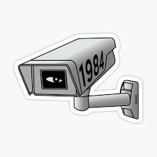

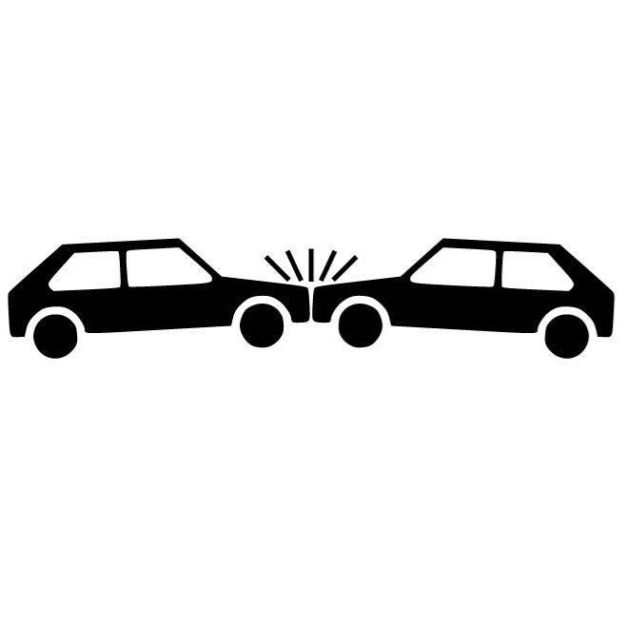
SYSTEM ARCHITECTURE
Cloud Server
CCTV Camera
Wifi Hotspot
Centralized station
Accident Spot

Slide 13
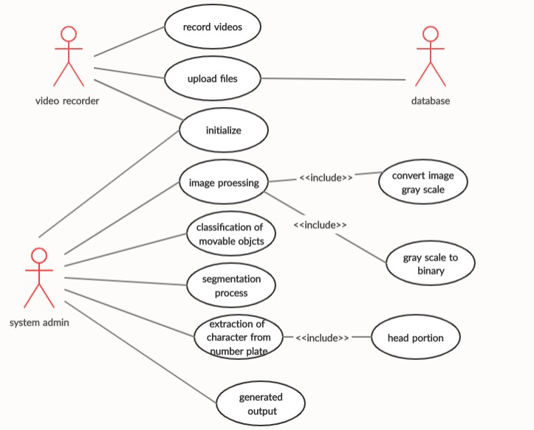
SYSTEM DESIGN – USECASE DIAGRAM

Slide 14
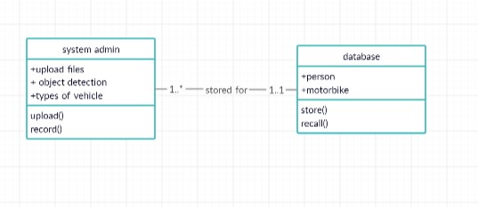
CLASS DIAGRAM

Slide 15
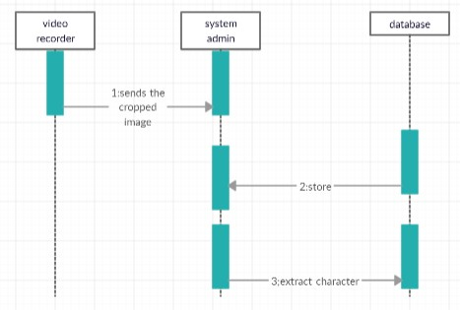
SEQUENCE DIAGRAM

Slide 16
MODULES
List of Module
1.Classification of movable objects
2. Segmentation
3. Recognition of characters

Slide 17
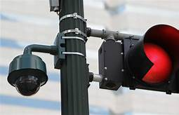
1.CLASSIFICATION OF MOVABLE OBJECTS
the surveillance camera that capture the movable objects from the traffic road. And it uploads to the database which is already created to store the video files for the further uses based on the needs of the system admin.
It uploads the video from the camera and stores the video in the database.
Admin uses the multiple functions to be done in the class

Slide 18
2. SEGMENTATION
Segmentation means to divide the frames into parts, or segments, which are definable, accessible, actionable, and profitable and have a growth potential. In other words, a company would find it impossible to target the entire market, because of time, cost and effort restrictions. Once the person-Car pair is obtained, the person images is given as input to accident detection model. While testing the accident detection model, some false detections were observed. So, the person image was cropped to get only top- fourth portion of image . They detected accident as recognition technology that uses YOLOV3 is the latest variant of a popular object detection algorithm YOLO compared to prior version.

Slide 19
SEGMENTATION -CONT
It features multi-scale detection ,stronger feature extractor network, and some changes in the loss function . As a result ,this network can now detect many more targets from big to small . As the rider Car Number and accident detection in case 1, bounding box is created, no further processing is necessary. Since in case 2, rider is not Car Number and accident detection, no bounding box is created.

Slide 20
3. RECOGNITION OF CHARACTERS
Automatic number-plate recognition is a technology that uses optical character recognition on images to read vehicle registration plates to create vehicle location data . Video Relay Interpreting(VRI) is used by police forces around the world for law enforcement purposes, including to check if a vehicle is registered or licensed. Video Relay Interpreting (VRI) can be used to store the images captured by the cameras as well as the text from the license plate, with some configurable to store a photograph of the driver.
Systems commonly use infrared lighting to allow the camera to take the picture at any time of day or night. Then optical character recognition (OCR) to extract the alphanumerics of the license plate.

Slide 21
SYSTEM IMPLEMENTATION -CODING
% Object for reading video file.
filename = 'C:\video\ca.mp4';
hVidReader = vision.VideoFileReader(filename, 'ImageColorSpace', 'RGB',...
'VideoOutputDataType', 'single');
hOpticalFlow = vision.OpticalFlow('OutputValue', 'Horizontal and vertical components in complex form', 'ReferenceFrameDelay', 3);
hMean1 = vision.Mean;
hMean2 = vision.Mean('RunningMean', true);
hMedianFilt = vision.MedianFilter;
hclose = vision.MorphologicalClose('Neighborhood', strel('line',5,45));
%Create a System object to detect foreground using gaussian mixture models.
hfdet = vision.ForegroundDetector(...
'NumTrainingFrames', 5, ... % only 5 because of short video
'InitialVariance', (30/255)^2); % initial standard deviation of 30/255
hblob = vision.BlobAnalysis(...
'CentroidOutputPort', false, 'AreaOutputPort', true, ...

Slide 22
CODING - CONT
'BoundingBoxOutputPort', true, 'OutputDataType', 'double', ...
'MinimumBlobArea', 250, 'MaximumBlobArea', 3600, 'MaximumCount', 80);
herode = vision.MorphologicalErode('Neighborhood', strel('square',2));
hshapeins1 = vision.ShapeInserter('BorderColor', 'Custom', ...
'CustomBorderColor', [0 1 0]);
hshapeins2 = vision.ShapeInserter( 'Shape','Lines', ...
'BorderColor', 'Custom', ...
'CustomBorderColor', [255 255 0]);
htextins = vision.TextInserter('Text', '%4d', 'Location', [1 1], ...
'Color', [1 1 1], 'FontSize', 12);
sz = get(0,'ScreenSize');
pos = [20 sz(4)-300 200 200];
hVideo1 = vision.VideoPlayer('Name','Original Video','Position',pos);
pos(1) = pos(1)+220; % move the next viewer to the right
hVideo2 = vision.VideoPlayer('Name','Motion Vector','Position',pos);

Slide 23
CODING - CONT
pos(1) = pos(1)+220;
hVideo3 = vision.VideoPlayer('Name','Thresholded Video','Position',pos);
pos(1) = pos(1)+220;
hVideo4 = vision.VideoPlayer('Name','accident','Position',pos);
% Initialize variables used in plotting motion vectors.
lineRow = 22;
firstTime = true;
motionVecGain = 20;
borderOffset = 5;
decimFactorRow = 5;
decimFactorCol = 5;
while ~isDone(hVidReader) % Stop when end of file is reached
frame = step(hVidReader); % Read input video frame
grayFrame = rgb2gray(frame);

Slide 24
CODING-CONT
ofVectors = step(hOpticalFlow, grayFrame); % Estimate optical flow
% The optical flow vectors are stored as complex numbers. Compute their
% magnitude squared which will later be used for thresholding.
y1 = ofVectors .* conj(ofVectors);
% Compute the velocity threshold from the matrix of complex velocities.
vel_th = 0.5 * step(hMean2, step(hMean1, y1));
% Threshold the image and then filter it to remove speckle noise.
segmentedObjects = step(hMedianFilt, y1 >= vel_th);
% Thin-out the parts of the road and fill holes in the blobs.
segmentedObjects = step(hclose, step(herode, segmentedObjects));
% Estimate the area and bounding box of the blobs.
[area, bbox] = step(hblob, segmentedObjects);
% Select boxes inside ROI (below white line).

Slide 25
CODING -CONT
Idx = bbox(:,1) > lineRow;
% Based on blob sizes, filter out objects which can not be cars.
% When the ratio between the area of the blob and the area of the
% bounding box is above 0.4 (40%), classify it as a car.
ratio = zeros(length(Idx), 1);
ratio(Idx) = single(area(Idx,1))./single(bbox(Idx,3).*bbox(Idx,4));
ratiob = ratio > 0.4; count = int32(sum(ratiob)); % Number of cars
bbox(~ratiob, :) = int32(-1);
% Draw bounding boxes around the tracked cars.
y2 = step(hshapeins1, frame, bbox);
% Display the number of cars tracked and a white line showing the ROI.
y2(22:23,:,:) = 1; % The white line.
y2(1:15,1:30,:) = 0; % Background for displaying count
result = step(htextins, y2, count);

Slide 26
CODING-CONT
% Generate coordinates for plotting motion vectors.
if firstTime
[R C] = size(ofVectors); % Height and width in pixels
RV = borderOffset:decimFactorRow:(R-borderOffset);
CV = borderOffset:decimFactorCol:(C-borderOffset);
[Y X] = meshgrid(CV,RV);
firstTime = false;
end
% Calculate and draw the motion vectors.
tmp = ofVectors(RV,CV) .* motionVecGain;
lines = [Y(:), X(:), Y(:) + real(tmp(:)), X(:) + imag(tmp(:))];
motionVectors = step(hshapeins2, frame, lines);

Slide 27
CODING-CONT
% Display the results
step(hVideo1, frame); % Original video
step(hVideo2, motionVectors); % Video with motion vectors
step(hVideo3, segmentedObjects); % Thresholded video
step(hVideo4, result); % Video with bounding boxes
end
foregroundDetector = vision.ForegroundDetector('NumGaussians', 3, ...
'NumTrainingFrames', 50);
V=VideoReader('C:\video\ca.mp4');
videoReader = vision.VideoFileReader('C:\video\ca.mp4');
for i = 1:150
frame = step(videoReader); % read the next video frame
foreground = step(foregroundDetector, frame);
end

Slide 28
CODING-CONT
% imwrite(frame,'C:\referenceimage.jpg','jpg');
imwrite(frame,'C:\Users\Venka\Desktop\refer\referenceimage.jpg','jpg');
videoPlayer = vision.VideoPlayer('Name', 'Detected Cars speed and wieght of accident ');
videoPlayer.Position(3:4) = [650,400]; % window size: [width, height]
se = strel('square', 3); % morphological filter for noise removal
% referenceimage=imread('C:\referenceimage.jpg');
referenceimage=imread('C:\Users\Venka\Desktop\refer\referenceimage.jpg');
X=zeros(2,121);
Y=zeros(2,121);
Z=zeros; while ~isDone(videoReader)
frame = step(videoReader); % read the next video frame
% Detect the foreground in the current video frame
foreground = step(foregroundDetector, frame);
% Use morphological opening to remove noise in the foreground

Slide 29
CODING-CONT
filteredForeground = imopen(foreground, se);
%-----------------------SPEED ---------------------------%
frame2=((im2double(frame))-(im2double(referenceimage)));
frame1=im2bw(frame2,0.1);
[Labelimage]=bwlabeln(frame1);
stats=regionprops(Labelimage,'basic');
BB=stats.BoundingBox;
i=2; %fblasst for
X(i)=BB(1);
Y(i)=BB(2);
Dist=((X(i)-X(i-1))^2+(Y(i)-Y(i-1))^2)^(1/2);
Z(i)=Dist;

Slide 30
CODING-CONT
M=median(Z);
%disp(M);
%clc;
%disp('speed=')
Speed=((M)*(120/8))/(4);
%disp(Speed);
%SPEED = M ???????????
i = i + 1;
SE = strel('disk',6);
frame3=imclose(frame1,SE);
step(videoReader);
pause(0.05);
%if(i==121) end; ??
%-----------------------SPEED ---------------------------%

Slide 31
CODING-CONT
for ii = 1:length(imageNames)
img = imread(fullfile(workingDir,'images',imageNames{ii}));
writeVideo(outputVideo,img)
end
close(outputVideo)
shuttleAvi = VideoReader(fullfile(workingDir,'accident.avi'));
ii = 1;
while hasFrame(shuttleAvi)
mov(ii) = im2frame(readFrame(shuttleAvi));
ii = ii+1;
end
figure
imshow(mov(1).cdata, 'Border', 'tight')

Slide 32
CODING-CONT
movie(mov,1,shuttleAvi.FrameRate)
myaddress = 'haritest69@gmail.com';
mypassword = 'Hari123456';
setpref('Internet','E_mail',myaddress);
setpref('Internet','SMTP_Server','smtp.gmail.com');
setpref('Internet','SMTP_Username',myaddress);
setpref('Internet','SMTP_Password',mypassword);
props = java.lang.System.getProperties;
%% i
props.setProperty('mail.smtp.auth','true');
props.setProperty('mail.smtp.socketFactory.class','javax.net.ssl.SSLSocketFactory');
props.setProperty('mail.smtp.socketFactory.port','465');
sendmail('ashwini.achu0310@gmail.com','accident detection system','recover your patient ','C:\Accident check\images\570.jpg')

Slide 33
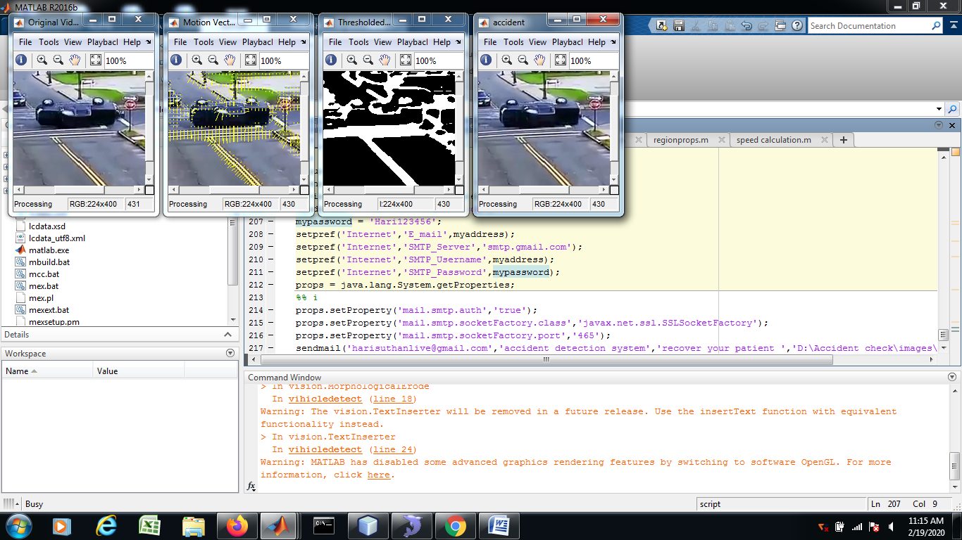
SAMPLE SCREENSHOT

Slide 34
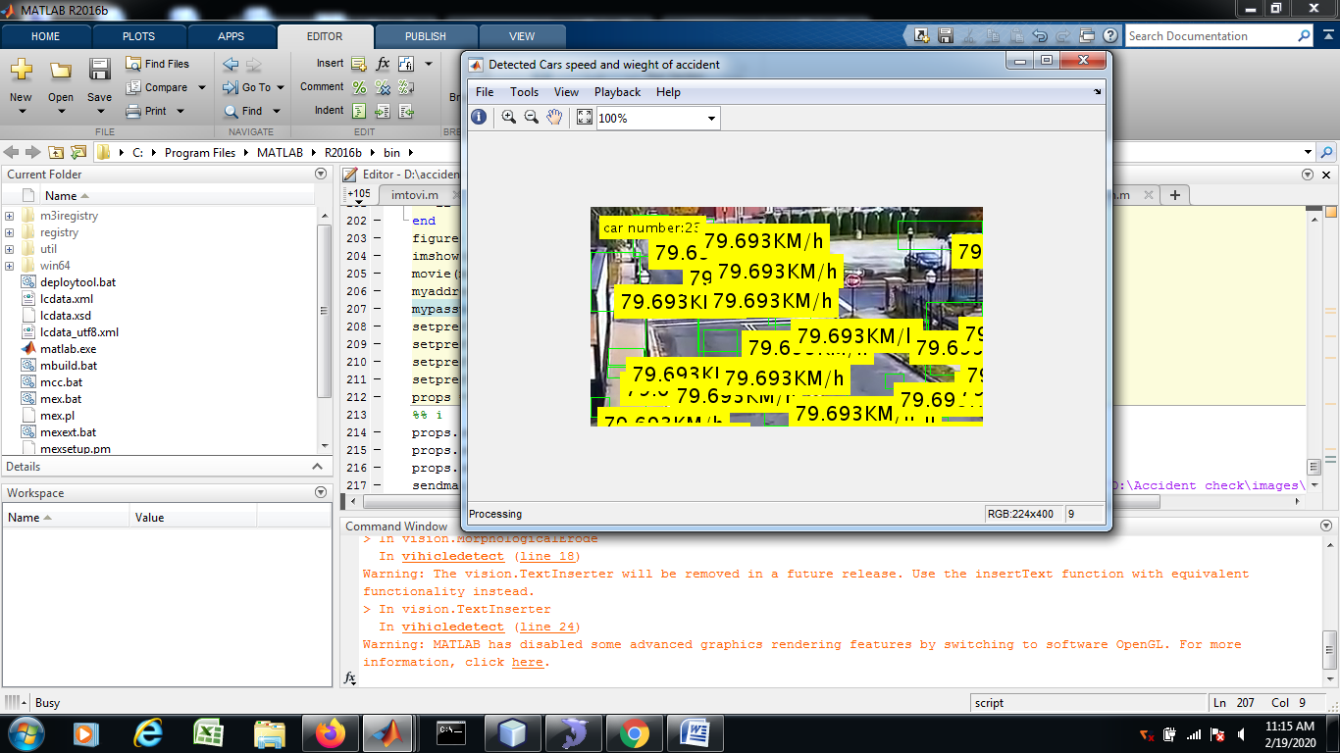
SCREENSHOT-CONT

Slide 35
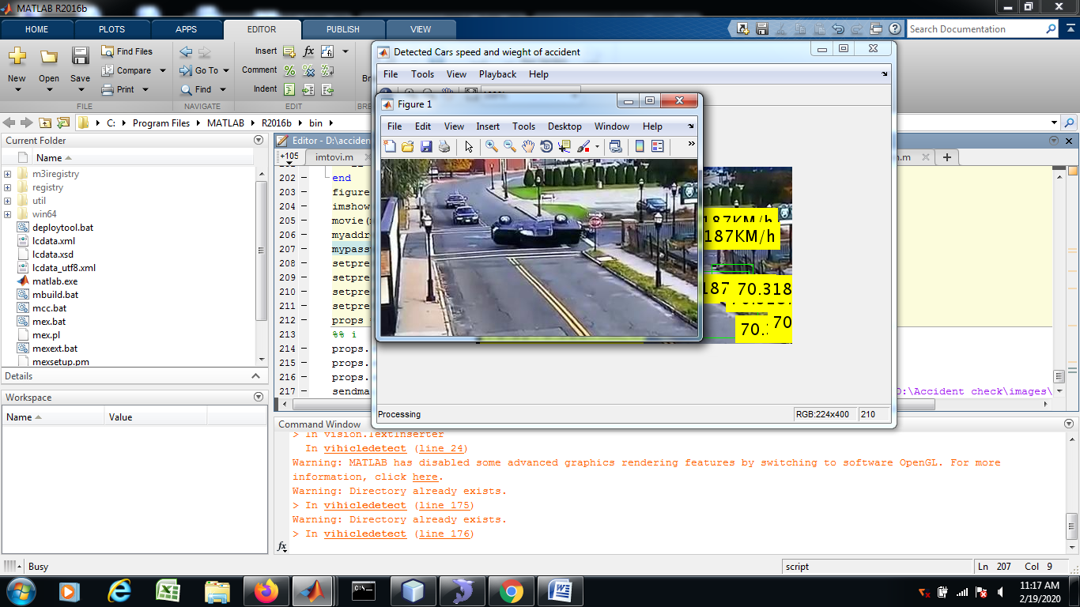
SCREENSHOT-CONT

Slide 36
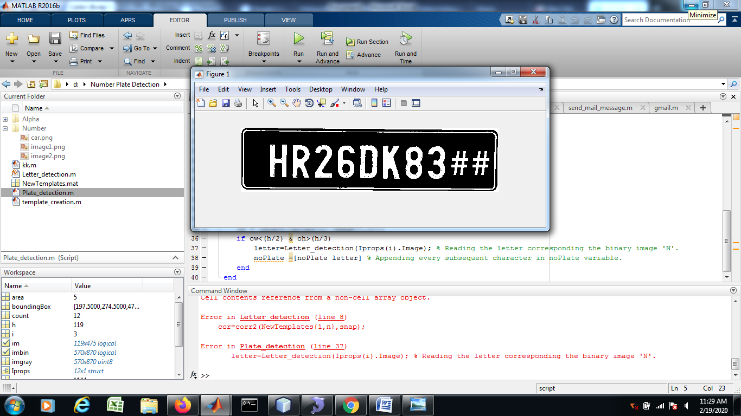
SCREENSHOT-CONT

Slide 37
CONCLUSION
This methods are efficient to detect accidents using both hardware and software methods which provide good results. Most of the discussed methods also provide the driver with the option of turning of the alarm in cases where the accident is not serious or false detections of an accident. Previous methods are either mostly dependent on some hardware like sensors that have to be present in the car or require a smart phone to be present within the car. While the use of such hardware can prove to be a more cost-efficient approach it has the drawback of being destroyed in the accident and hence giving spurious or no readings at all. Hence, an approach that does not depend on any hardware device or sensor that is associated with the car is required for the detection of traffic accidents.

Slide 38
REFERENCE
"Global status report on road safety 2015", World Health Organization, 2016. [Online]. Available: http://www.who.int/violence_injury_preve ntion/road_safety_status/2015/en/. (Accessed: 22- Mar- 2016)
B. Prachi, D. Kasturi and C. Priyanka, "Intelligent Accident-Detection And Ambulance- Rescue System", International Journal Of Scientific & Technology Research, Vol. 3, No. 6, 2016.
M. Ruikar, "National statistics of road traffic accidents in India", Journal of Orthopedics, Traumatology and Rehabilitation, vol. 6, no. 1, p. 1, 2013.

